Slide 1
TOPIC:Water Resource Management
SUB-TOPIC:Rainfall Analysis and Prediction using Python
Presented by: Sakshi B K

Slide 2
Problem Statement
To analyze historical rainfall data in India from 1901 to 2015.
To identify trends and patterns in rainfall over the years.
To build a machine learning model for rainfall prediction.

Slide 3
Objective
Perform Exploratory Data Analysis (EDA) on rainfall data.
Visualize annual rainfall trends.
Develop a Linear Regression model to predict annual rainfall.

Slide 4
Dataset Details
Dataset: Rainfall in India (1901-2015).
Contains monthly rainfall for different states and years.
Used to compute annual rainfall and analyze historical trends.

Slide 5
Tools & Technologies
Google Colab
Python Libraries: Pandas, Matplotlib, Seaborn, scikit-learn
GitHub for code management

Slide 6
Exploratory Data Analysis
Calculated average annual rainfall from monthly values.
Visualized rainfall trend over years using line plots.
Identified fluctuations and long-term rainfall patterns.

Slide 7
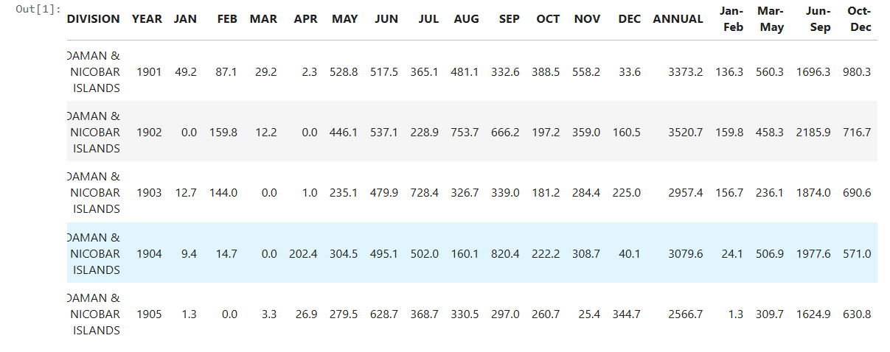
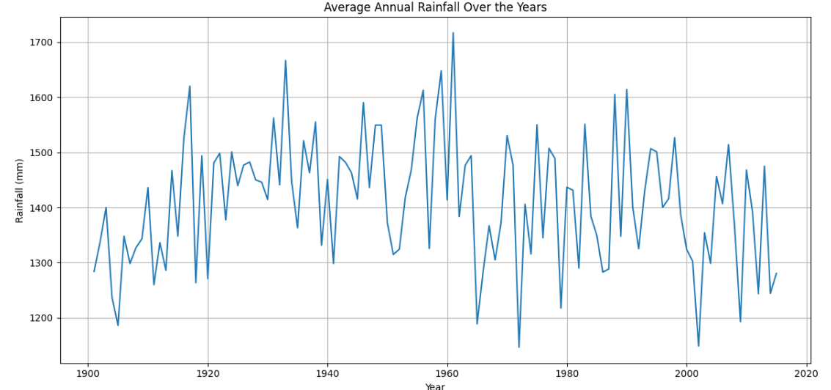
WEEK 1-OUTPUT

Slide 8
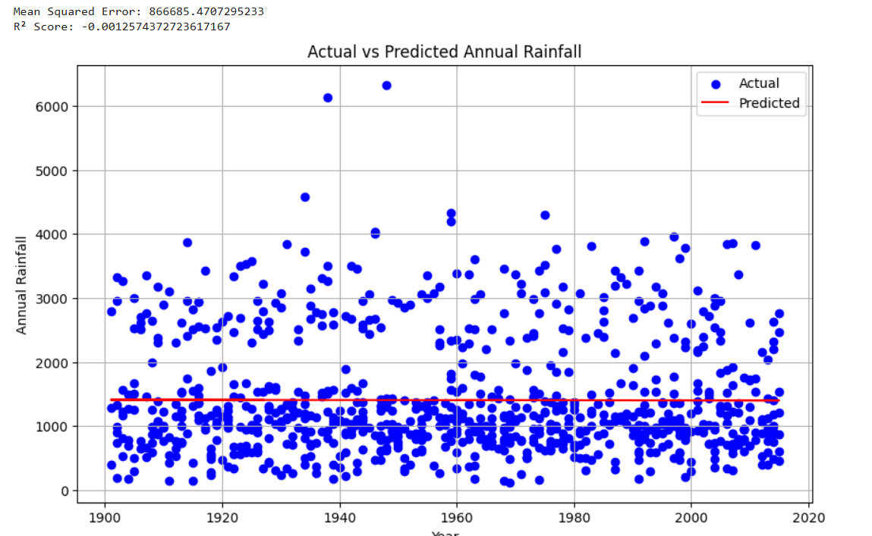
WEEK 2-OUTPUT

Slide 9
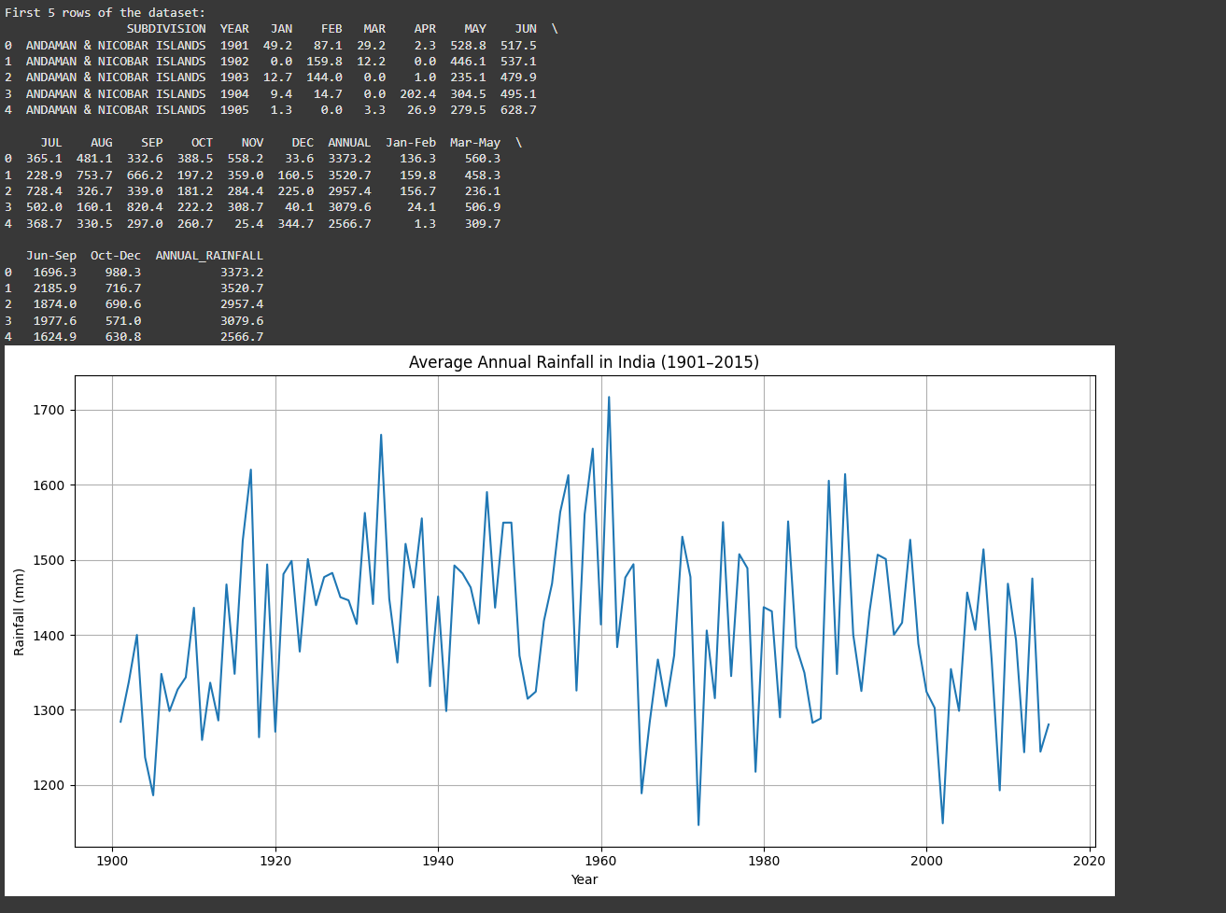
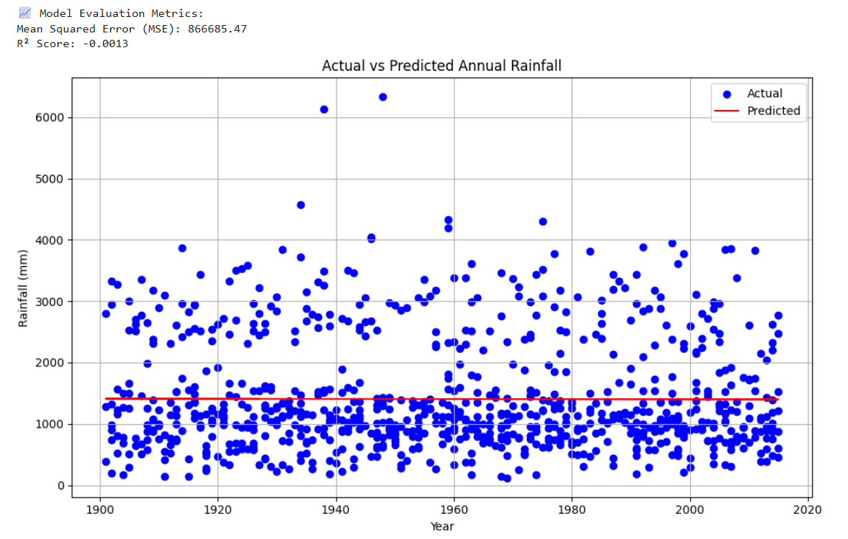
WEEK 3-OUTPUT

Slide 10
Modeling / Prediction
Used Linear Regression to model the relationship between year and annual rainfall.
Split data into training and test sets.
Evaluated model using R² Score and Mean Squared Error (MSE).

Slide 11
Conclusion
Rainfall patterns vary significantly over time.
Linear Regression provides a basic estimate of future rainfall trends.
Can be used for planning and water resource allocation.

Slide 12
Future Scope
Use advanced models like LSTM or Random Forest for better accuracy.
Region-wise prediction for localized planning.
Integrate real-time weather data for dynamic forecasting.

Slide 13
References
Rainfall dataset from Rainfall dataset sourced from public open data platform-Kaggle
Python documentation: pandas, matplotlib, sklearn.
Colab and GitHub for development and sharing.

